Slide 1

MobileDiser
Merchandising Inventory System

Slide 2
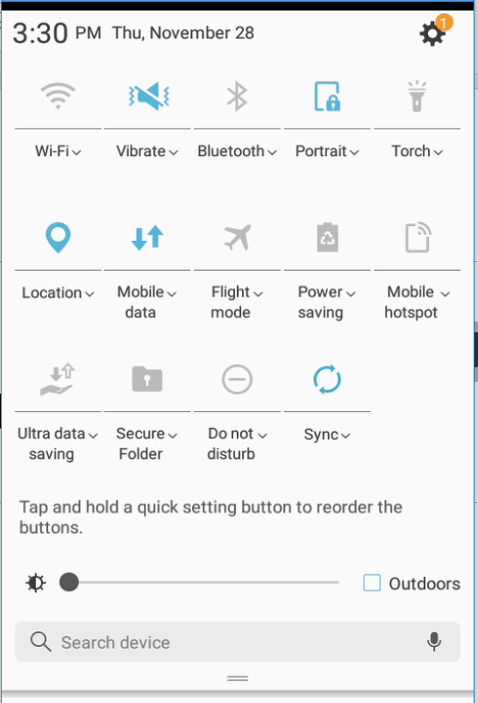
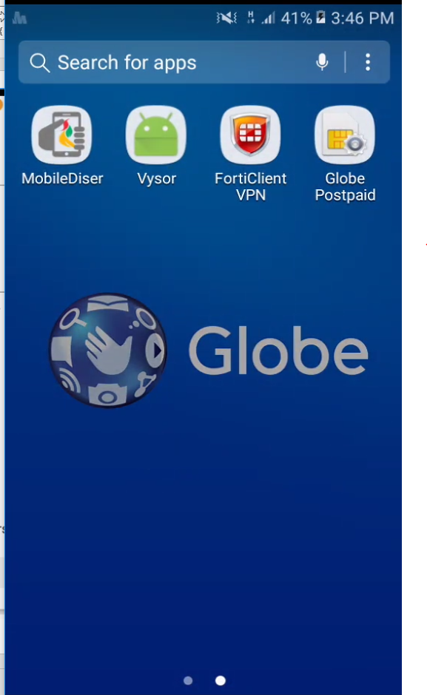
Before use:
Please make sure that the device is connected to the internet (mobile data)
Ensure the location services is enable
Open Mobilediser App
2
1
3

Slide 3
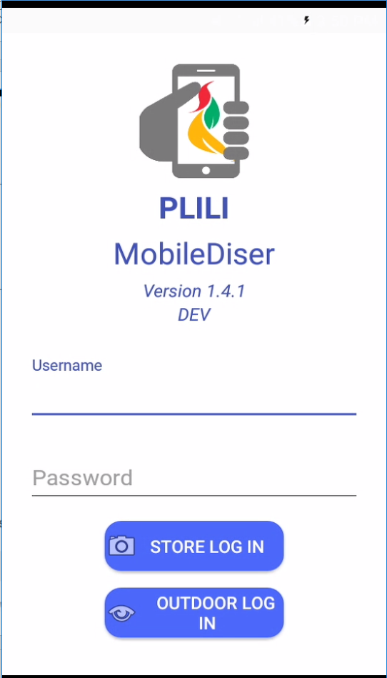
Login Screen
Input Username
Input Password
Tap Store or Outdoor Login Button
1
2
Store Login – For inventory activity of merchandiser within customer’s area.
Outdoor Login – For viewing of announcements and schedules outside customer’s area.
3

Slide 4
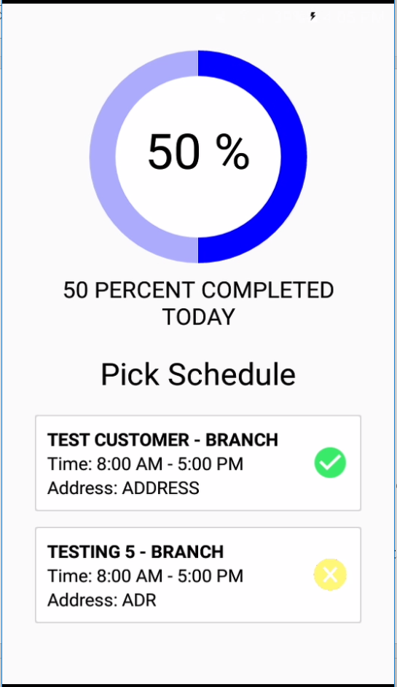
Pick Schedule Screen (Store Login)
- Where all assigned schedules for the day are displayed
Select schedule with yellow icon only
Rules:
1. Merchandiser must be logged near the store area. This will prompt an error otherwise.
2. Follow the ordering of schedule. Merchandiser cannot be proceed on the next customer if the previous customer is not yet visited.
1
Legends:
Green – Visited Store/Customer (with login and logout)
Yellow – Unvisited Store/Customer

Slide 5
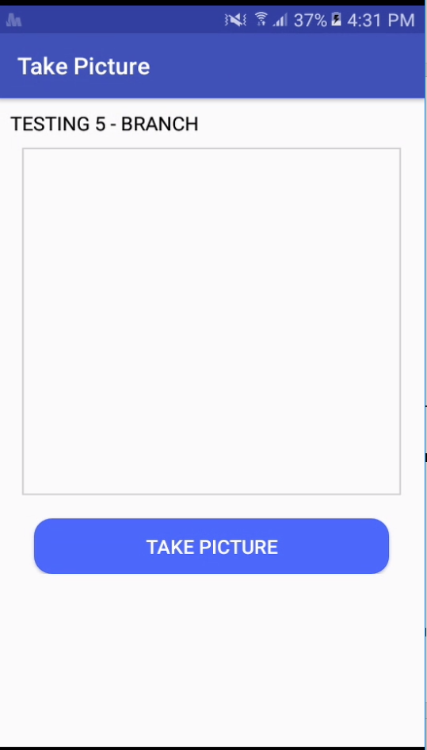
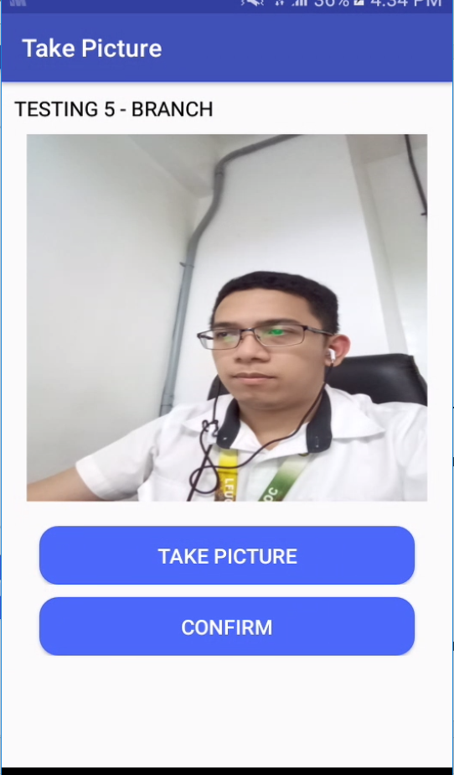
Take Picture
Tap Take Picture Button
Tap Confirm
1
2
*An Error message will prompt if no photo is taken

Slide 6
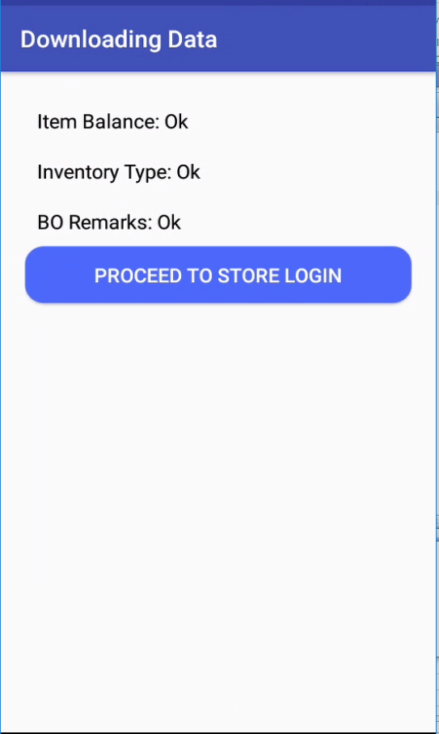
Downloading Data
Where all components used for offline saving of inventory are loaded.
Make sure all status are “Ok” else close the mobile app then try to store login again
Tap Proceed to Store Login Button
1

Slide 7
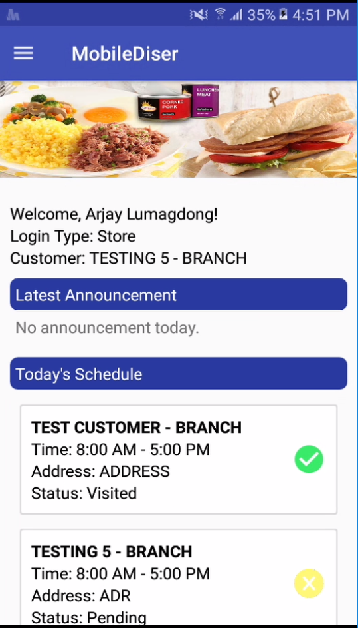

Home Screen
This Screen displays
Name of Merchandiser logged in the application
Log-in type
Name of customer if the log-in type is “Store Login”
Latest announcements from the administrator
Today’s schedule of the merchandiser
Tap this Icon to display the sidebar menu
Note:
Swipe down the screen to reload and refresh the app in order to get the latest updates from the server (update of schedule, announcements etc..)

Slide 8
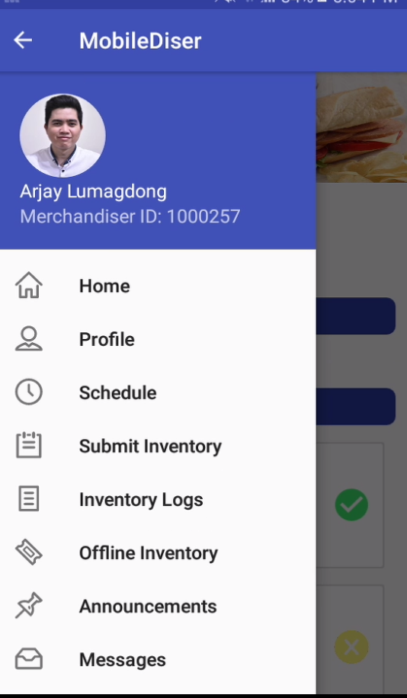

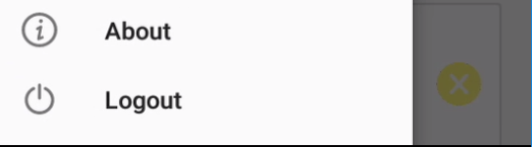
Sidebar Menu Screen
This Screen contains
Merchandiser Image, Name and ID.
Home screen of the application.
Profile page of the merchandiser.
Schedule of the merchandiser.
Submission of inventory per customer.
History of all submitted inventory.
Announcements from administrator.
Send Message functionality.
About page including application information and copyright
Logout button.
Tap this Icon to hide the sidebar menu

Slide 9
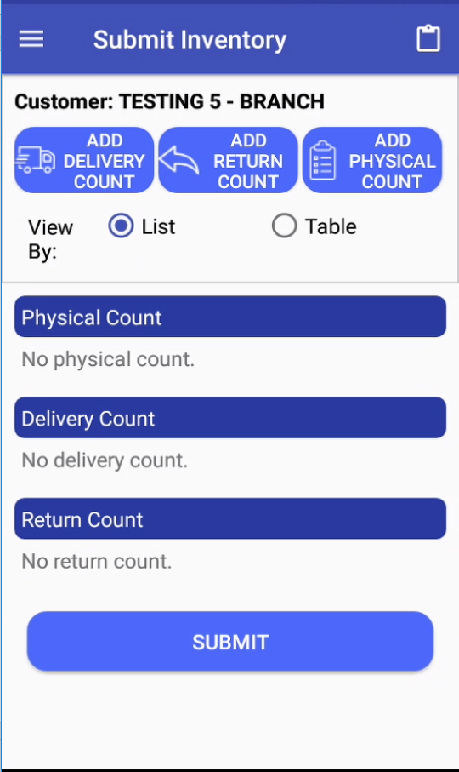

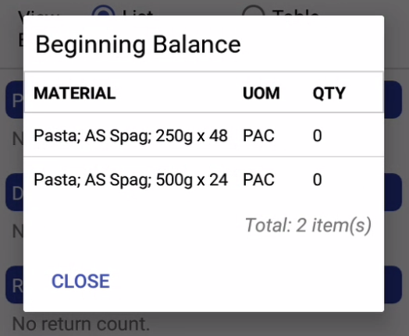
Submit Inventory
This Screen includes the summary of all inventory count (Delivery, Return and Physical Count)
1
2
3
Tap this Icon to show inventory balance of all carried material in the store
Tap Add Delivery Count Button
Tap Add Return Count Button
Tap Add Physical Count Button
Tap Submit Button
Note:
Delivery and return count is a must prior physical count
All product SKU must be declared in physical count.
Inventory can be submitted in an offline mode.
if the app will be used for the first time in the store and all beginning balance are zero, delivery count and physical must be equal in order to generate beginning balance for the next visit in the store
4

Slide 10
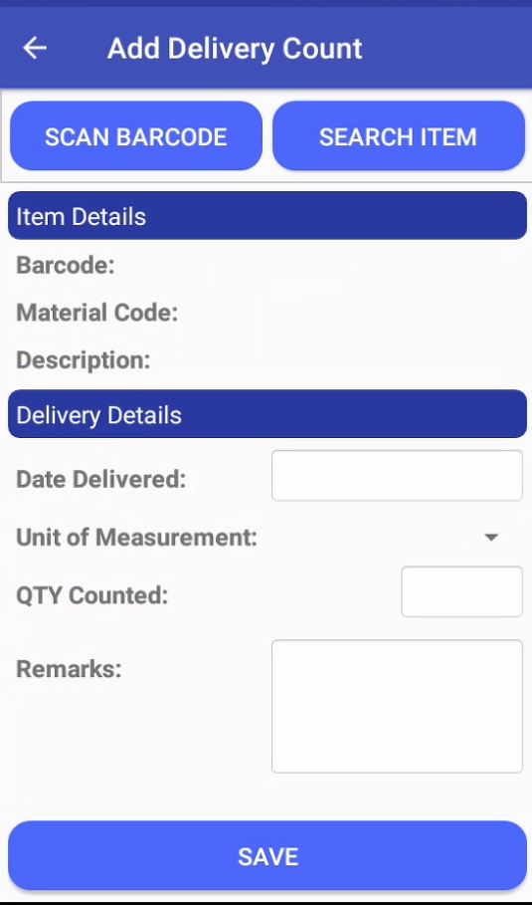
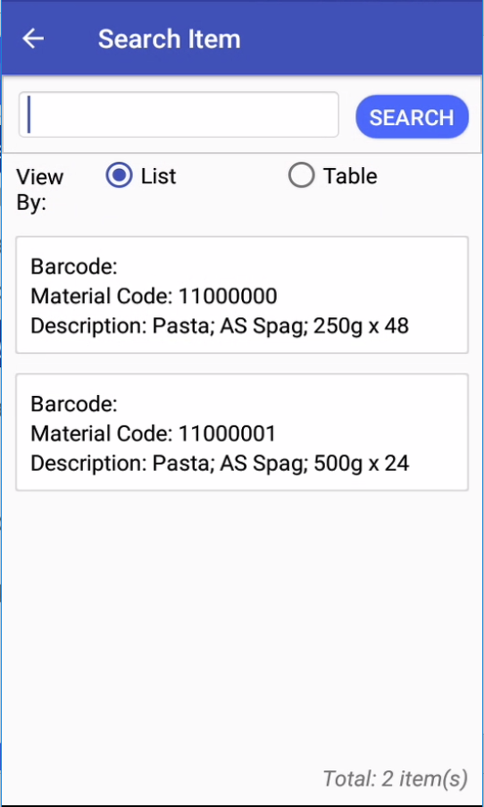
Delivery Count
Tap Search Item Button
Select One Material
Input Qty Counted
Select Unit of Measurement
Select Date Delivered
Tap Save Button
1
2
5
4
3
Note:
You can search a material by inputting text inside a search box then tap search button
6

Slide 11
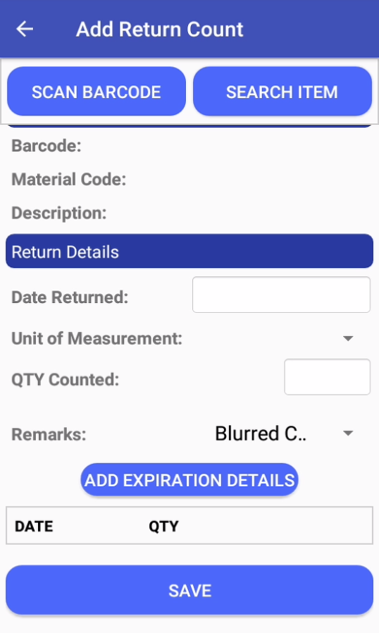
Return Count
Tap Search Item Button
Select One Material
Input Qty Counted
Select Unit of Measurement
Select Date Return
Select Remarks
Tap Add Expiration Details
Tap Save Button
1
2
5
4
3
6
Note:
Qty Counted must be equal to the sum of qty under expiration details
All declared return must have RTV number, if the item does not have RTV it should be in the BO Area location located in physical count form
7
8

Slide 12
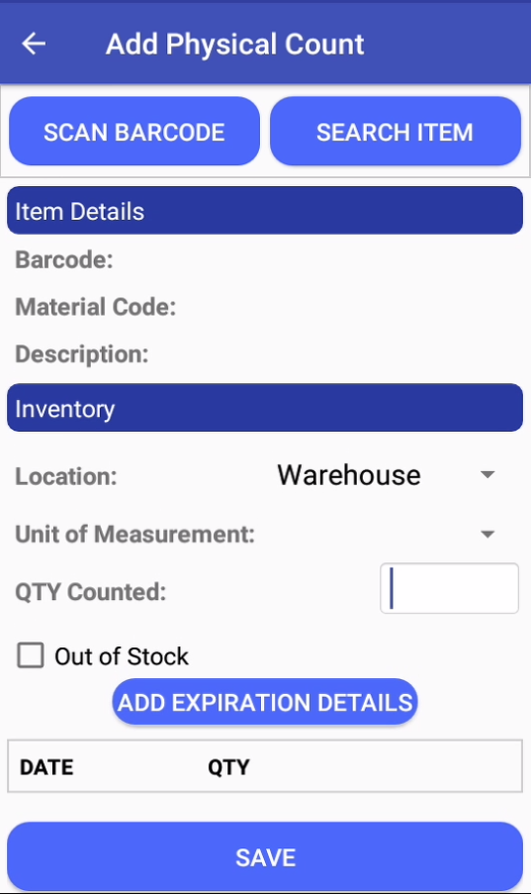
Return Count
Tap Search Item Button
Select One Material
Input Qty Counted
Select Location (Shelves, Warehouse, BO Area)
Select Unit of Measurement
Tap Add Expiration Details
Tap Save Button
1
2
4
5
3
Note:
Tap checkbox if the material is Out of Stock
6
7

Slide 13
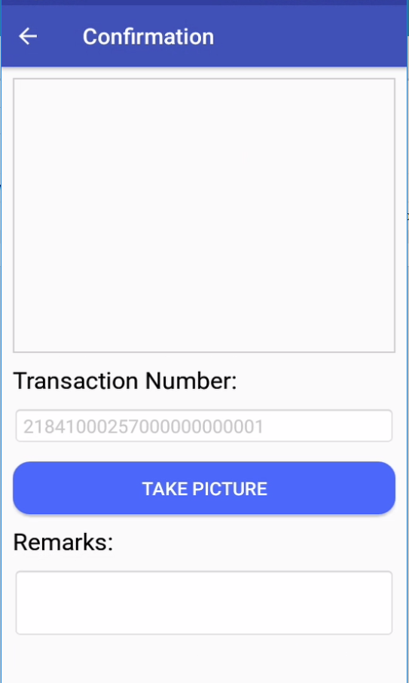
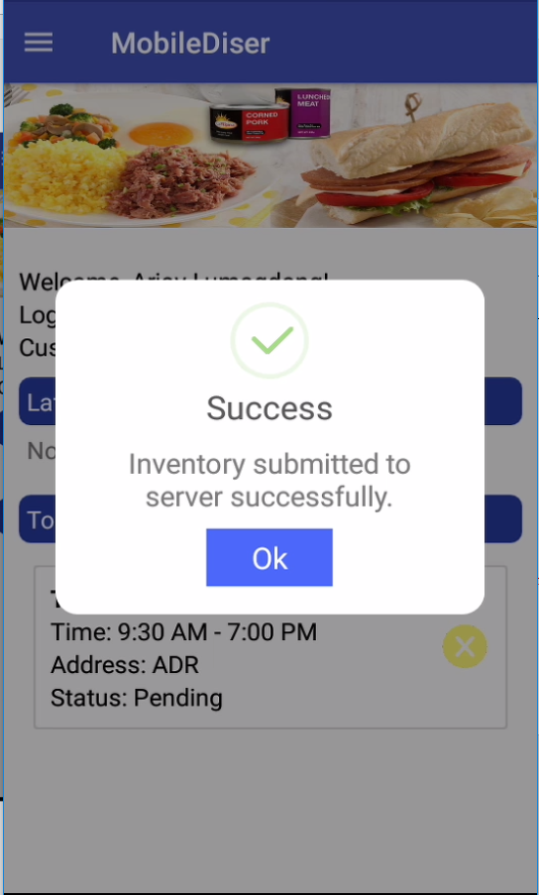
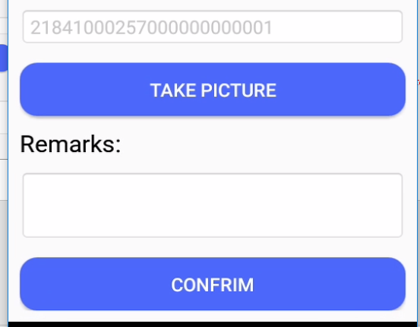
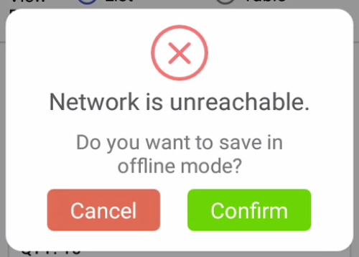
Submit Inventory
Tap Take Picture Button
Input Remarks (Optional)
Tap Confirm Button to Submit
Tap Ok Button
Note:
If the app has no internet connection it will proceed in offline saving
1
4
2
3

Slide 14
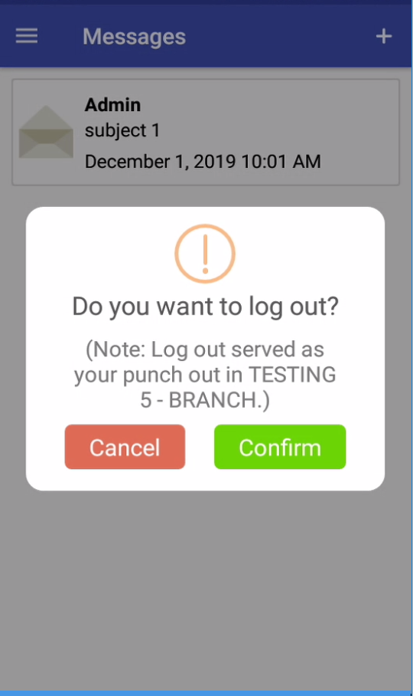
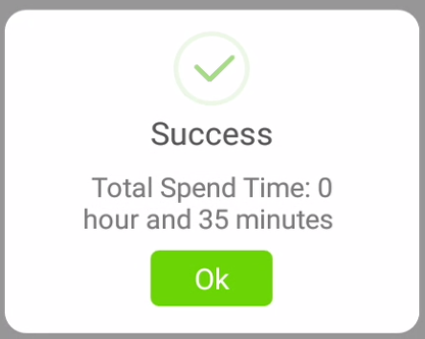
Logout
Tap Logout Menu
Tap Confirm Button
Tap Ok Button
2
3
Note:
Merchandiser must be logout near the store area. This will prompt an error otherwise.
1

Slide 15
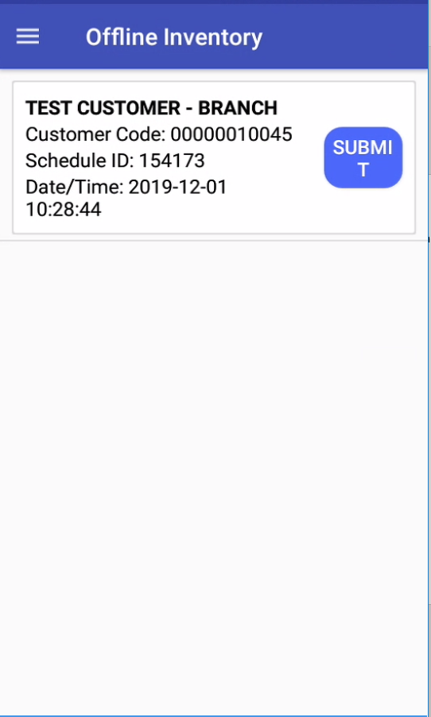
Offline Inventory
Viewing of submitted inventories offline
1. Tap Submit Button
1

Slide 16
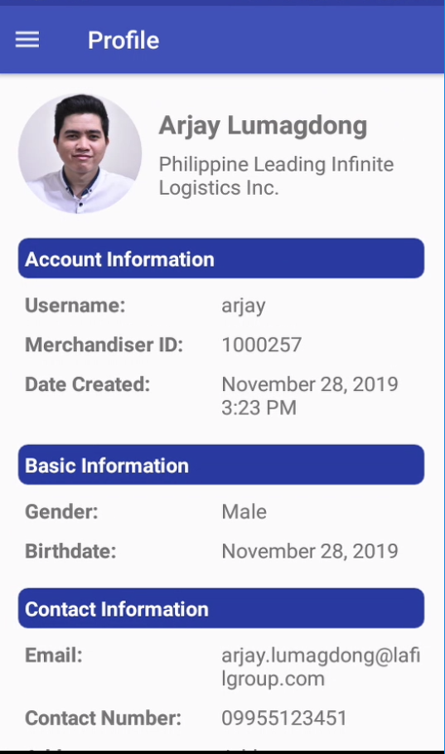
Profile Screen
Viewing of information about merchandiser

Slide 17
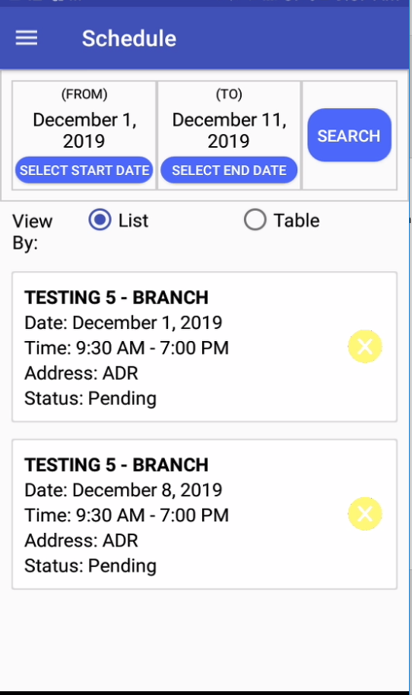
Schedule Screen
Viewing of merchandiser’s schedule
Tap Start Date
Tap End Date
Tap Search Button
3
1
2

Slide 18
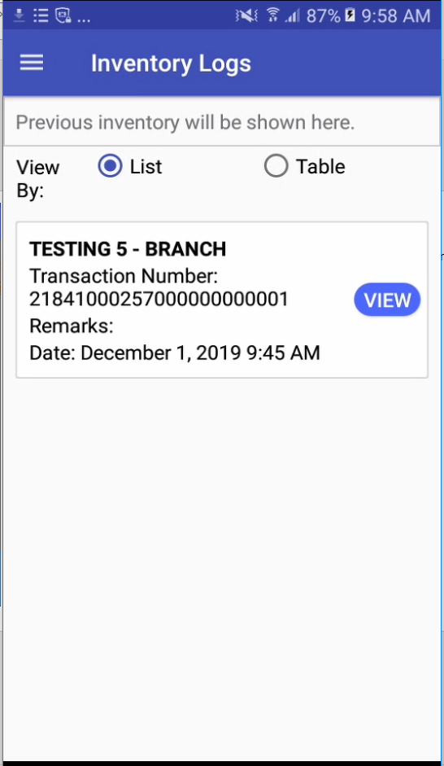
Inventory Log Screen
Viewing of merchandiser’s submitted inventories
Tap View Button to show details
1

Slide 19
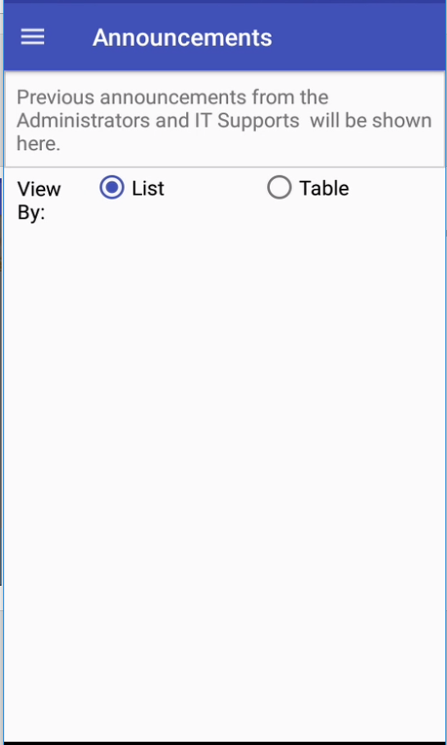
Announcements Screen
Viewing of announcements posted by mobilediser admin

Slide 20
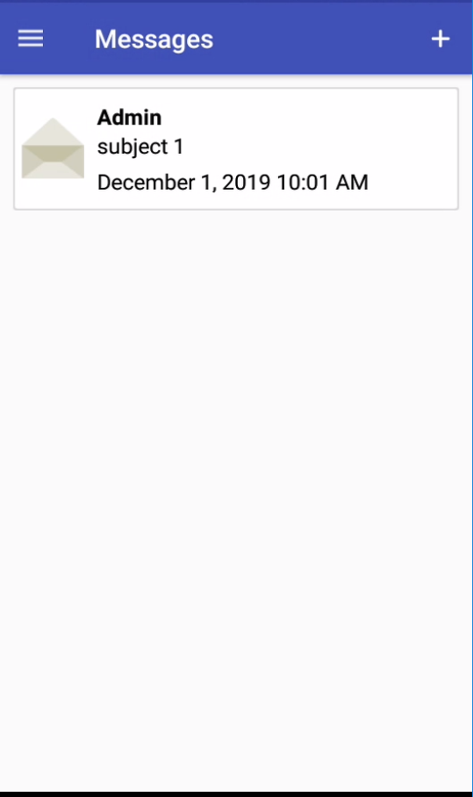
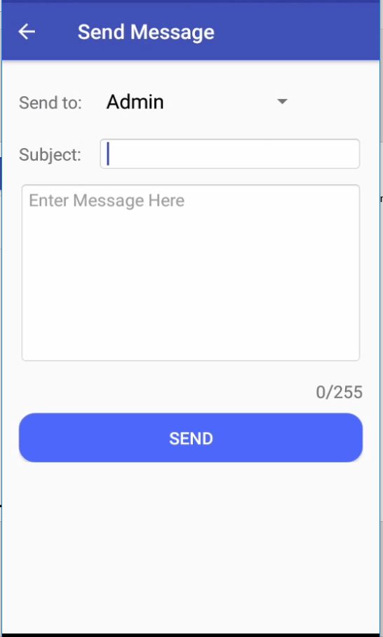
1
Messages Screen
Tap Plus(+) Sign Button
Select Recipient
Input Subject
Input Message
Tap Send Button
2
3
4
5

Slide 21
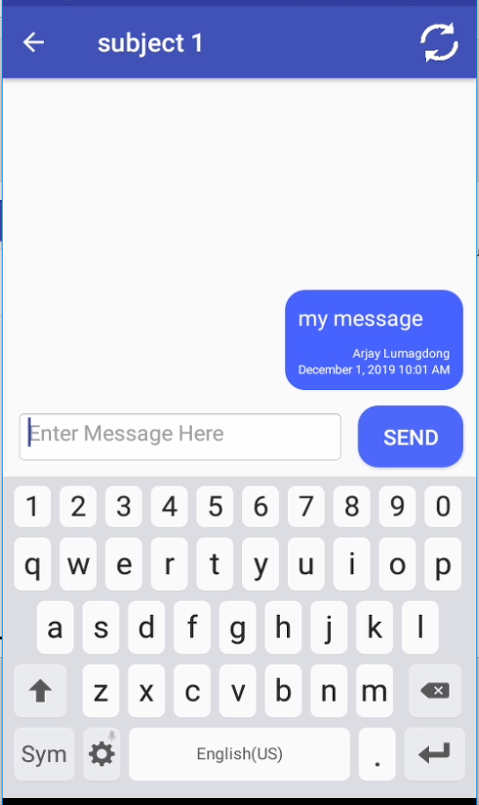

4
Conversation Screen
Tap Message Item
Input Message
Tap Send Button
Tap Reload Icon to refresh
1
2
3
Note:
Always tap reload icon to update and receive the messages from the recipient

